Slide 1
My Journal to Python
NAME: 葉非爾
TEACHER: MY DEAR GREAT TEACHER

Slide 2
agenda
Python
Input and output: input() and print()
Data types: strings,list, dict , numerisc
Operators ON data type:
CONTROLS : IF- | IF –ELSIF |-F-ELSE
LOOP: FOR |WHILE | RANGE() | BREAK | CONTINUE
FUNCTION:
PARAMETERS(ARGUMETNS)
RECURSIVE FUNCTION
LAMBDA FUNCTION

Slide 3
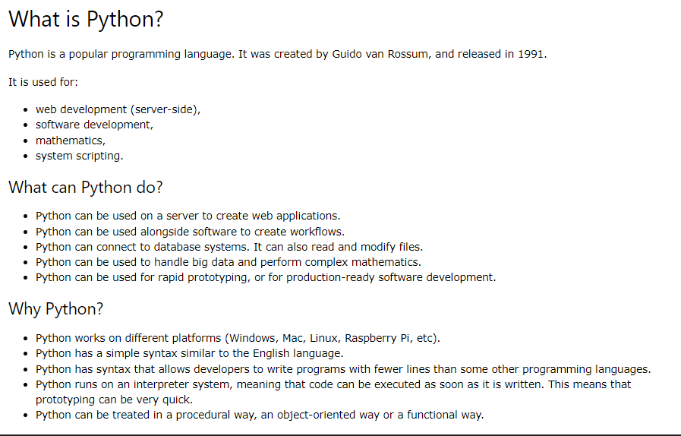

Python

Slide 4


Data types: python strings
Strings in python are surrounded by either single quotation marks, or double quotation marks
‘hello’ is the same as “hello”
You can display strings literal with the print() function:
input output
Example:

Slide 5
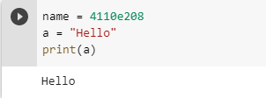
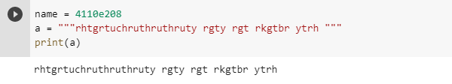
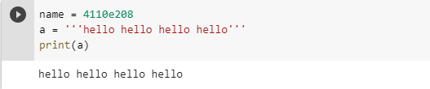
Assign String to a Variable Assigning a string to a variable is done with the variable name followed by an equal sign and the string:
Multiline Strings You can assign a multiline string to a variable by using three quotes:
Example
You can use three double quotes:
Example:
Three single quotes
example

Slide 6
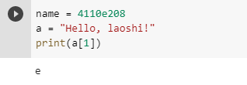
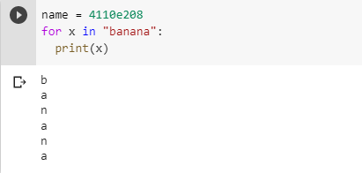
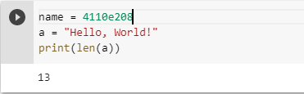
Strings are Arrays Like many other popular programming languages, strings in Python are arrays of bytes representing unicode characters. However, Python does not have a character data type, a single character is simply a string with a length of 1. Square brackets can be used to access elements of the string.
Example
Get the character at position 1 (remember that the first character has the position 0):
Looping through a string since arrays are strings, we can loop through the characters in a string, with a for loop.
Example
Loop through the letters in the word "banana":
String length to get the length of a string, use the len() function
Example
The len()function returns the length of a string:

Slide 7
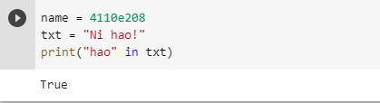
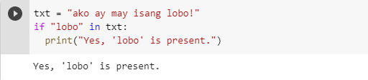
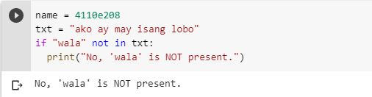
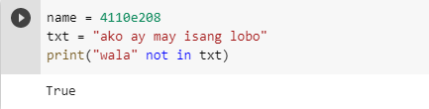
Check string to check if a certain
To check if a certain phrase or character is present in a string, we can use the keyword in
Example
Check if "free" is present in the following text:
Use it in an if statement: Example Print only if "free" is present:
Check if NOT To check if a certain phrase or character is NOT present in a string, we can use the keyword not in
Use it an if statement Example print only if “wala" is NOT present:
Example
Check if “wala" is NOT present in the following text:

Slide 8
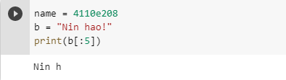
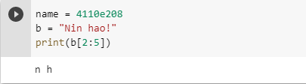
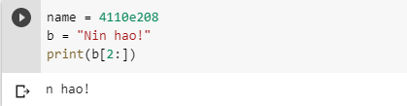
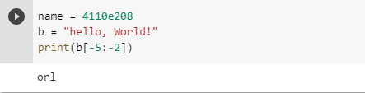
Python - Slicing Strings
Slice From the Start By leaving out the start index, the range will start at the first character:
Slicing
You can return a range of characters by using the slice syntax.
Specify the start index and the end index, separated by a colon, to return a part of the string
Example
Get the characters from the start to position 5 (not included):
Example
Get the characters from position 2 to position 5 (not included):
Slice To the End By leaving out the end index, the range will go to the end:
Negative Indexing Use negative indexes to start the slice from the end of the string:
Example
Get the characters from position 2, and all the way to the end:

Slide 9
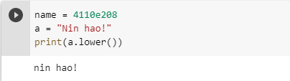
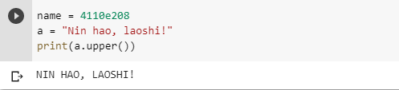
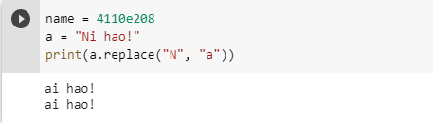

Python - Modify Strings Python has a set of built-in methods that you can use on strings. Upper Case
Lower Case
Example
The lower() method returns the string in lower case:
Example
The upper() method returns the string in upper case:
Remove Whitespace
Whitespace is the space before and/or after the actual text, and very often you want to remove this space.
Replace String
Example
The replace() method replaces a string with another string:
Example
The strip() method removes any whitespace from the beginning or the end:

Slide 10
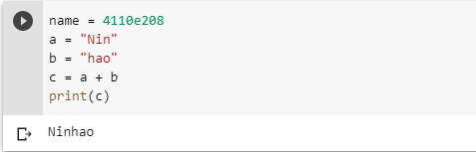
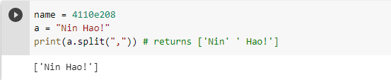
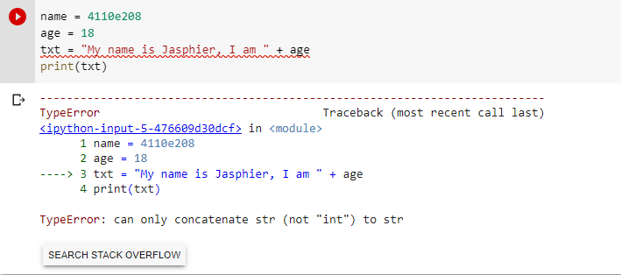
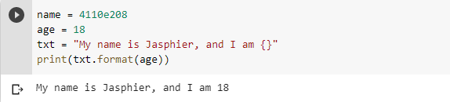
Split String The split() method returns a list where the text between the specified separator becomes the list items.
Python - String Concatenation
String Concatenation
To concatenate, or combine, two strings you can use the + operator.
Example
The split() method splits the string into substrings if it finds instances of the separator:
Example
Merge variable a with variable b into variable c
Python - Format - Strings
String Format
As we learned in the Python Variables chapter, we cannot combine strings and numbers like this:
But we can combine strings and numbers by using the format() method

Slide 11
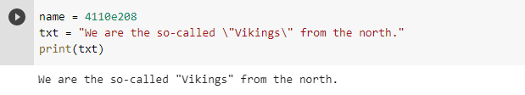
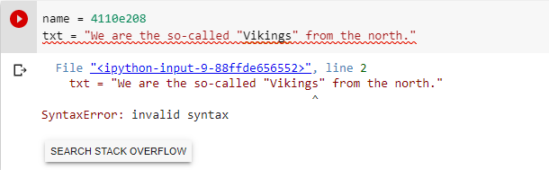
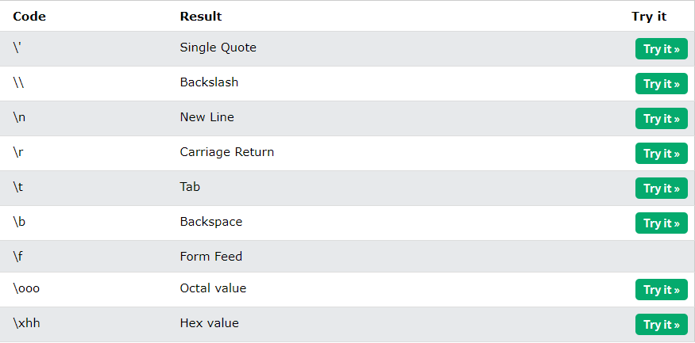
Python - Escape Characters
To fix this problem, use the escape character \”:
Escape Character
To insert characters that are illegal in a string, use an escape character.
An escape character is a backslash \ followed by the character you want to insert.
An example of an illegal character is a double quote inside a string that is surrounded by double quotes:
Example
The escape character allows you to use double quotes when you normally would not be allowed:
Example
You will get an error if you use double quotes inside a string that is surrounded by double quotes:
Escape Characters
Other escape characters used in Python:

Slide 12
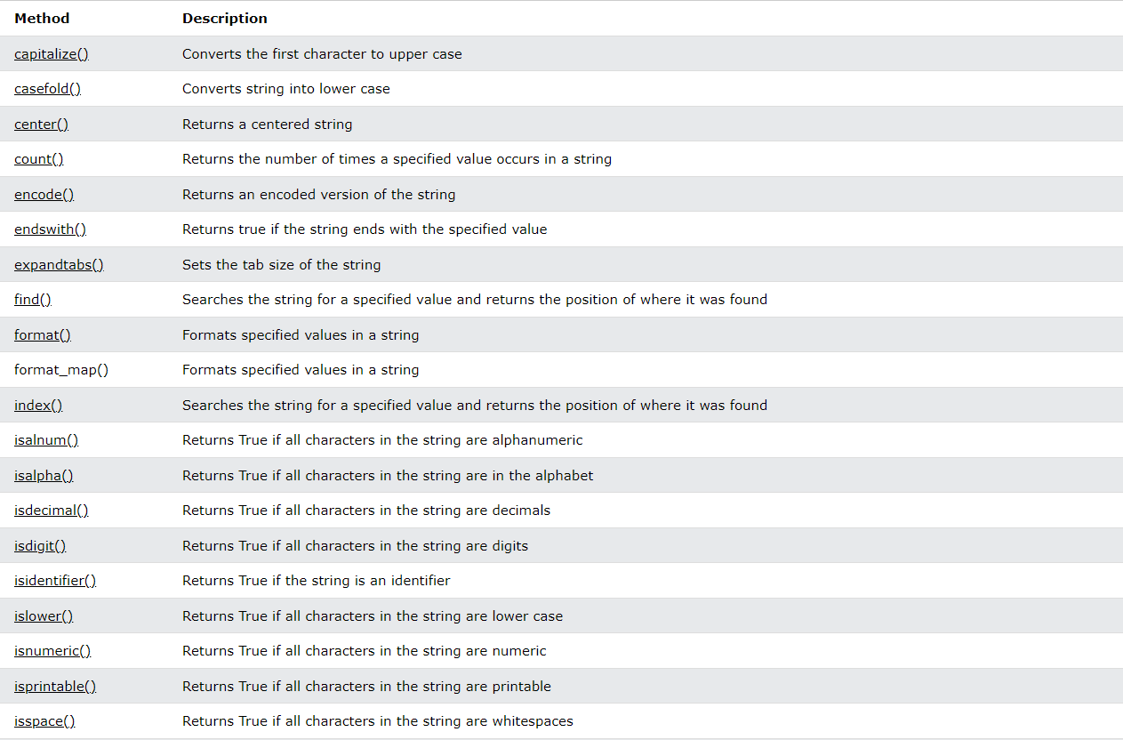
String method:

Slide 13
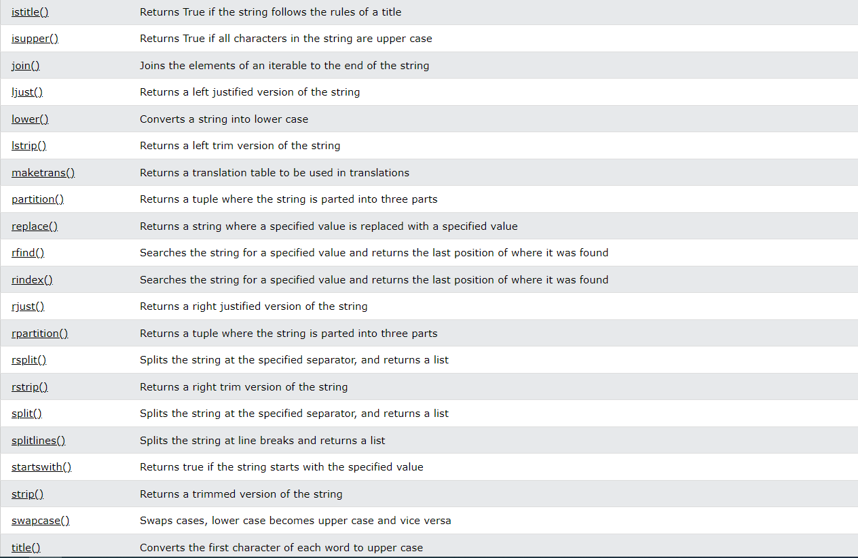

Slide 14
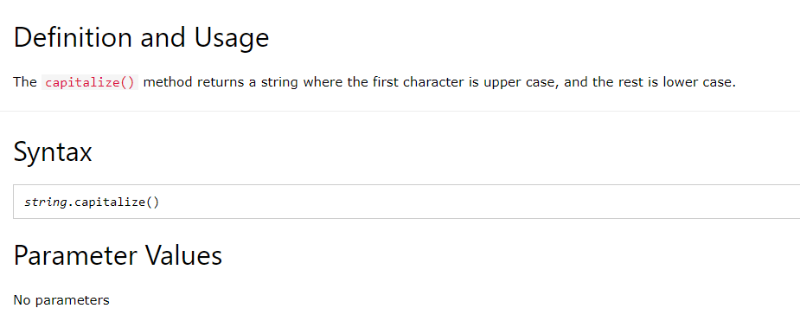
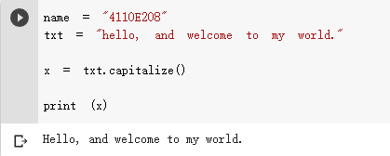
PYTHON STRING CAPITALIZE() METHOD
Example:

Slide 15
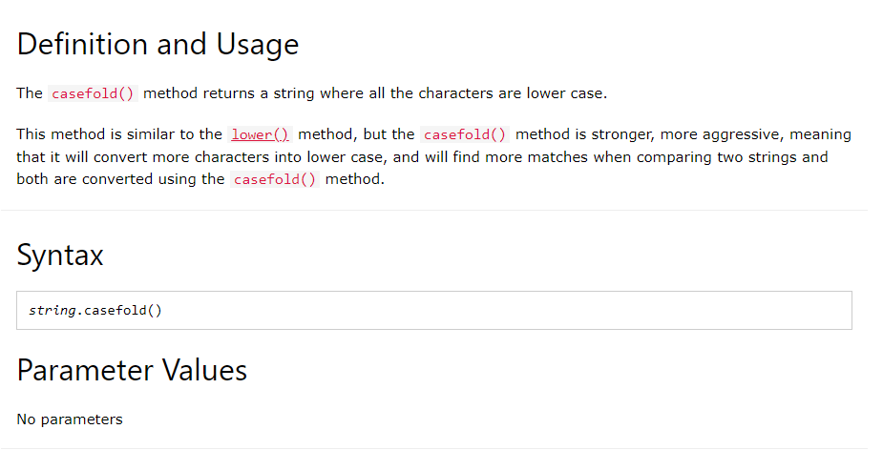
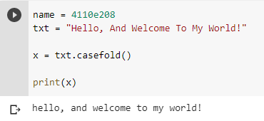
Example:
PYTHON STRING casefold() Method

Slide 16
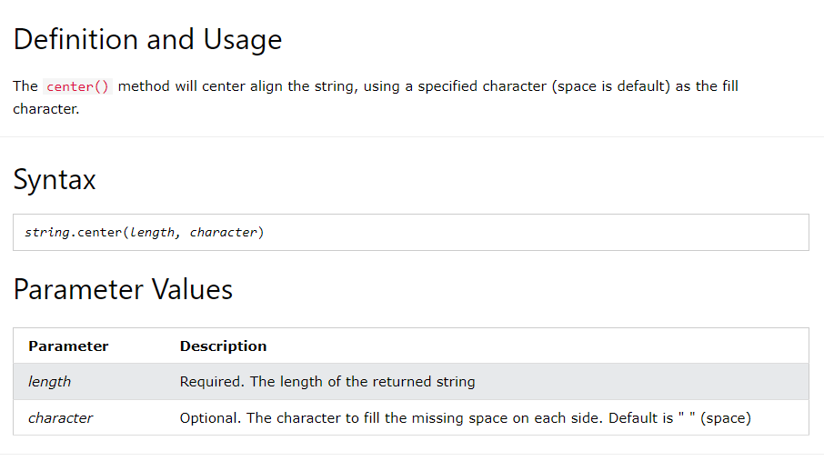
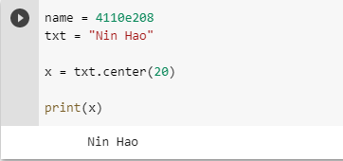
Python String center() Method
Example
Print the word “nin hao", taking up the space of 20 characters, with “nin hao" in the middle:

Slide 17
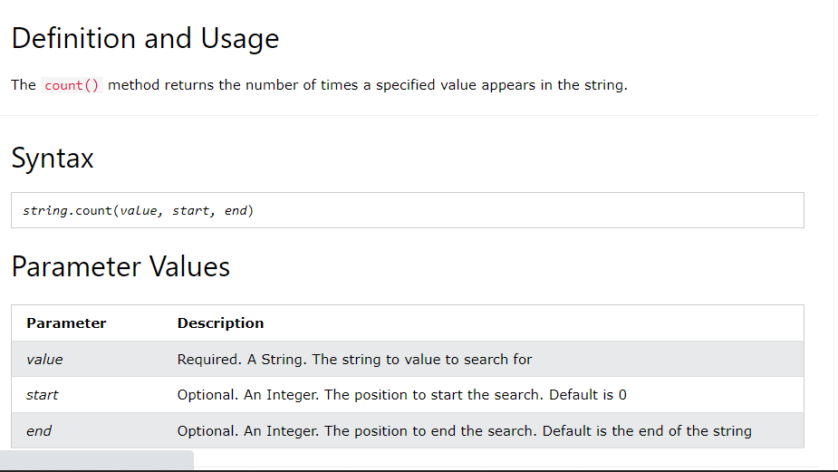
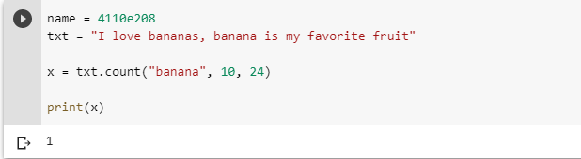
Python String count() Method
Example
Search from position 10 to 24:

Slide 18
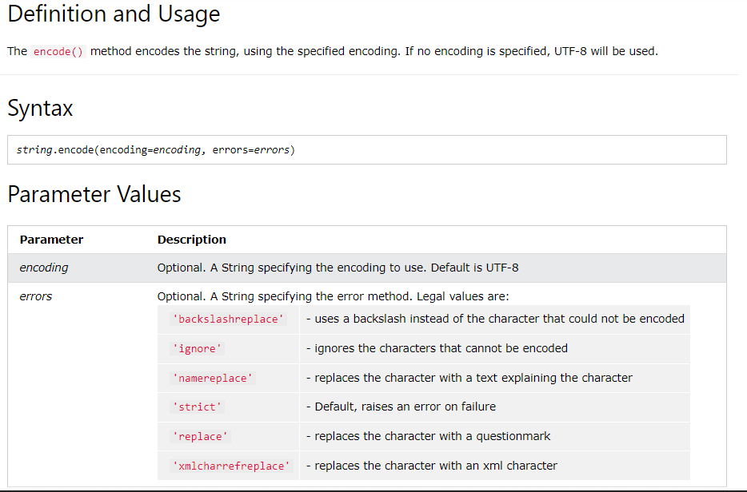
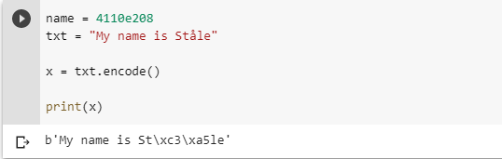
Python String encode() Method
Example
UTF-8 encode the string:

Slide 19
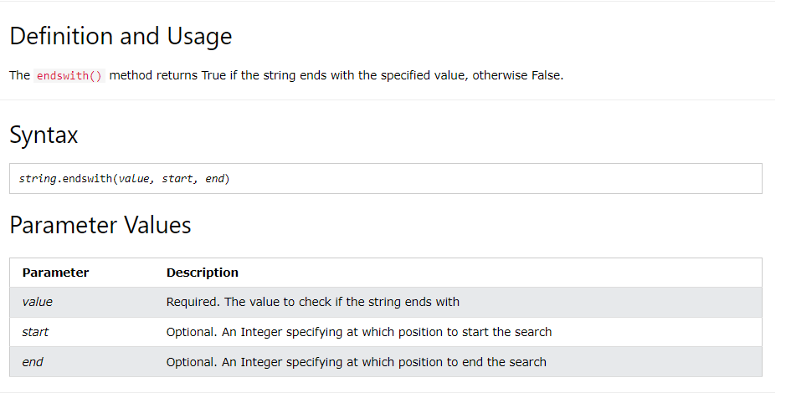
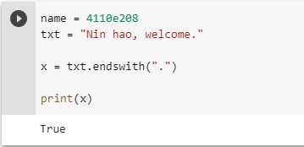
Python String endswith() Method
Example
Check if the string ends with a punctuation sign (.):

Slide 20
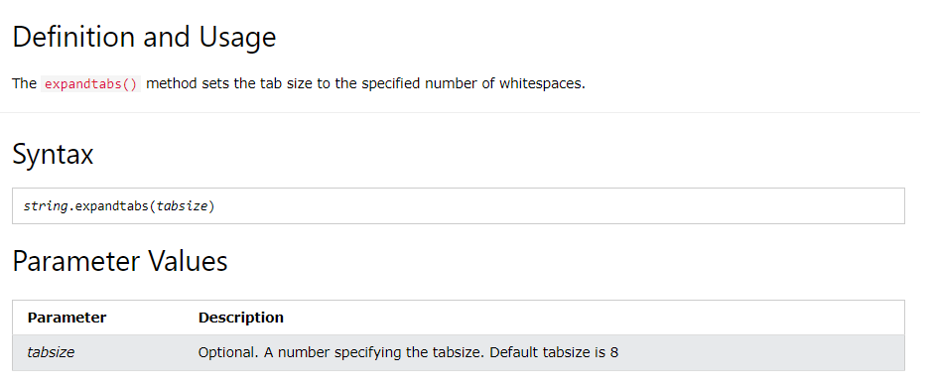
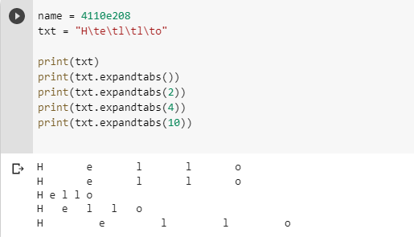
Python String expandtabs() Method
Example
See the result using different tab sizes:

Slide 21
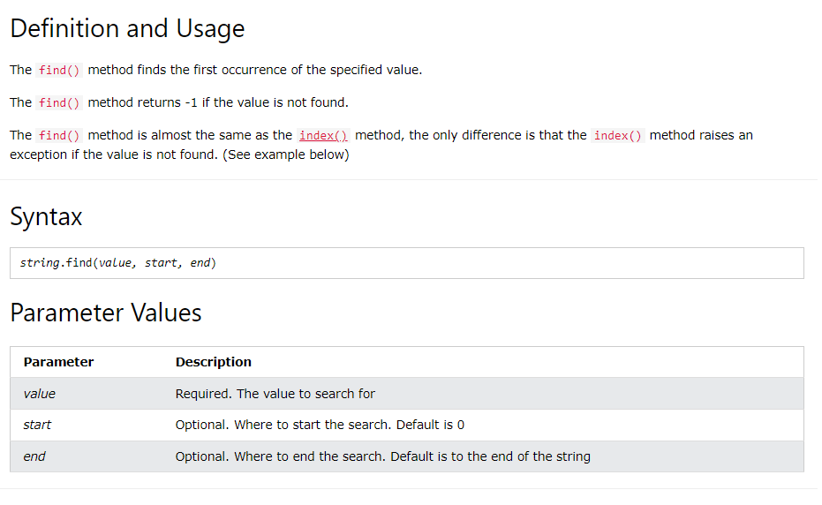
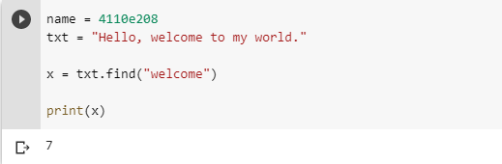
Python String find() Method
Example
Where in the text is the word "welcome"?:

Slide 22
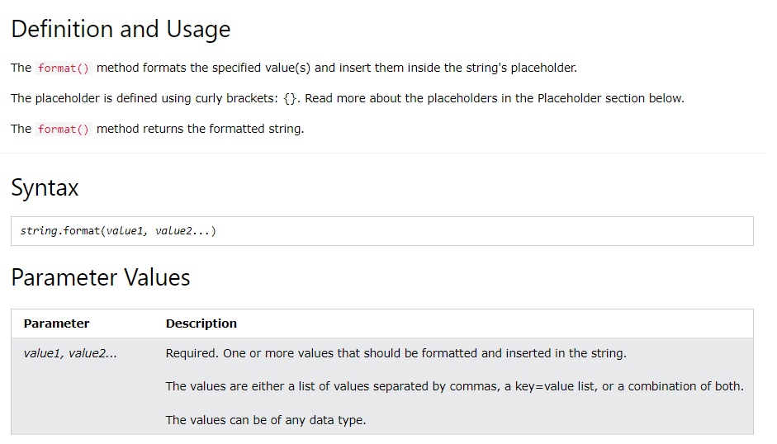
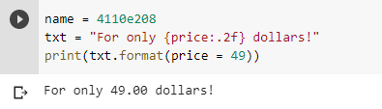
Python String format() Method
Example
Insert the price inside the placeholder, the price should be in fixed point, two-decimal format:

Slide 23
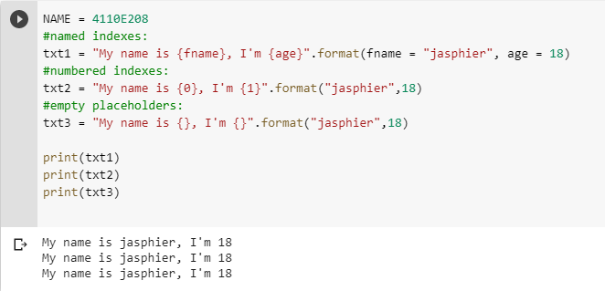
The Placeholders
The placeholders can be identified using named indexes {price}, numbered indexes {0} , or even empty placeholders {}
EXAMPLE WHEN
Using different placeholder values

Slide 24
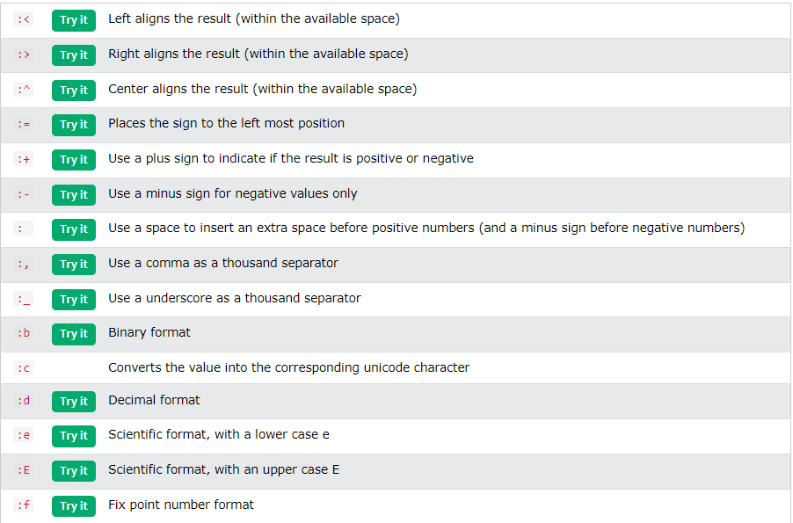
FORMATTING TYPES
Inside the placeholders you can add a formatting type to format the result:

Slide 25
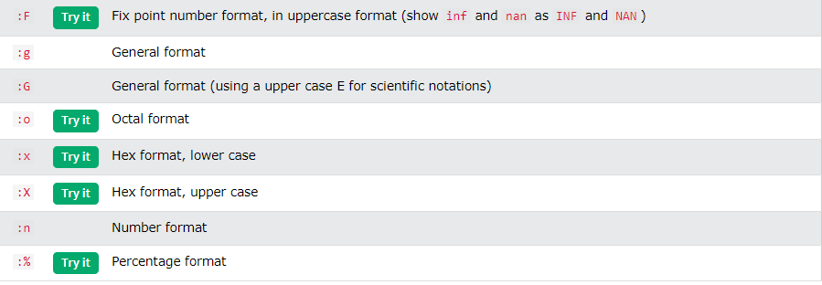

Slide 26
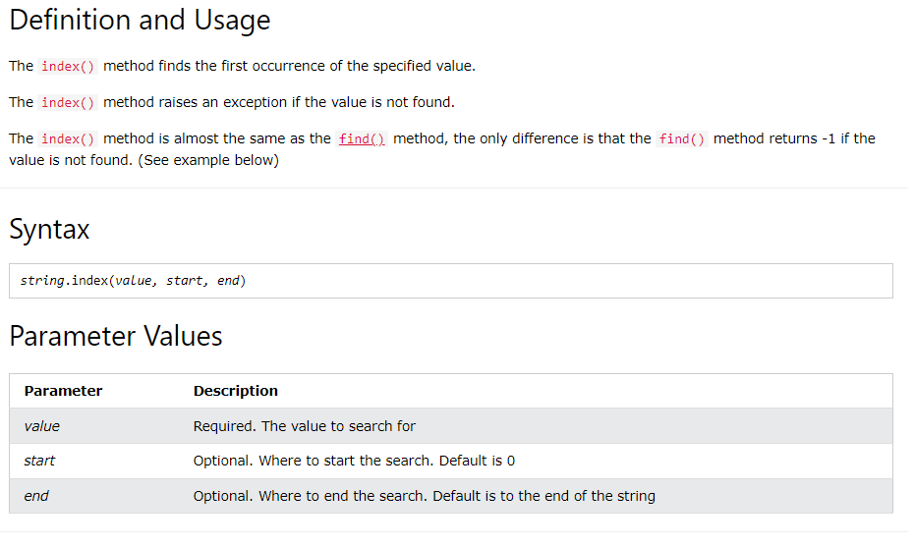
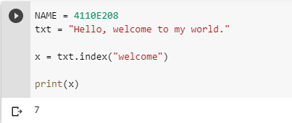
Python String index() Method
Example
Where in the text is the word "welcome"?:

Slide 27


Python String isalnum() Method
Example
Check if all the characters in the text is alphanumeric:

Slide 28


Python String isalpha() Method
Example
Check if all the characters in the text is alphabetic:

Slide 29


Python String isdigit() Method
Example
Check if all the characters in the text are digits:

Slide 30


Python String isidentifier() Method
Example
Check if the strings are valid identifiers:

Slide 31


Python String islower() Method
Example
Check if all the characters in the text are in lower case:

Slide 32


Python String isnumeric() Method
Example
Check if all the characters in the text are numeric:

Slide 33


Python String isprintable() Method
Example
Check if all the characters in the text are printable:

Slide 34


Python String isspace() Method
Example
Check if all the characters in the text are whitespaces:

Slide 35


Python String istitle() Method
Example
Check if each word start with an upper case letter:

Slide 36


Python String isupper() Method
Example
Check if all the characters in the text are in upper case:

Slide 37


Python String join() Method
Example
Join all items in a dictionary into a string, using the word "TEST" as separator:

Slide 38


Python String ljust() Method
Example
Using the letter "O" as the padding character:

Slide 39


Python String lower() Method
Example
Lower case the string:

Slide 40


Python String lstrip() Method
Example
Remove the leading characters:

Slide 41


Python String maketrans() Method
Example
Use a mapping table to replace many characters:

Slide 42


Python String partition() Method
Example
If the specified value is not found, the partition() method returns a tuple containing: 1 - the whole string, 2 - an empty string, 3 - an empty string:

Slide 43


Python String replace() Method
Example
Replace all occurrence of the word "one":

Slide 44


Python String rfind() Method
Example
Where in the text is the last occurrence of the letter "e"?:

Slide 45


Python String rindex() Method
Example
Where in the text is the last occurrence of the letter "e"?:

Slide 46


Python String rjust() Method
Example
Using the letter "O" as the padding character:

Slide 47


Python String rpartition() Method
Example
If the specified value is not found, the rpartition() method returns a tuple containing: 1 - an empty string, 2 - an empty string, 3 - the whole string:

Slide 48


Python String rsplit() Method
Example
Split the string into a list with maximum 2 items:

Slide 49


Python String rstrip() Method
Example
Remove the trailing characters if they are commas, s, q, or w:

Slide 50


Python String split() Method
Example
Split the string, using comma, followed by a space, as a separator:

Slide 51


Python String splitlines() Method
Example
Split the string, but keep the line breaks:

Slide 52


Python String startswith() Method
Example
Check if position 7 to 20 starts with the characters "wel":

Slide 53


Python String strip() Method
Example
Remove the leading and trailing characters:

Slide 54


Python String swapcase() Method
Example
Make the lower case letters upper case and the upper case letters lower case:

Slide 55


Python String title() Method
Example
Make the first letter in each word upper case:

Slide 56


Python String translate() Method
Example
Replace any "S" characters with a "P" character:

Slide 57


Python String upper() Method
Example
Upper case the string:

Slide 58


Python String zfill() Method
Example
Fill the string with zeros until it is 10 characters long:

Slide 59


Square brackets
Python Lists
Lists are used to store multiple items in a single variable.
Lists are one of 4 built-in data types in Python used to store collections of data, the other 3 are Tuple, Set, and Dictionary, all with different qualities and usage.
Lists are created using square brackets:
Python - Access List Items
List items are indexed and you can access them by referring to the index number:
Index number
Square bracket

Slide 60




Negative Indexing
Negative indexing means start from the end
-1 refers to the last item, -2 refers for the second last item etc
Range of Indexes
You can specify a range of indexes by specifying where to start and where to end the range.
When specifying a range, the return value will be a new list with the specified items.
By leaving out the start value, the range will start at the first item:
Example
Range of indexes
This example returns the items from the beginning to, but NOT including, "kiwi":

Slide 61


Python - Change List Items
To change the value of a specific item, refer to the index number:
Example
Change the second item:
Change a Range of Item Values
To change the value of items within a specific range, define a list with the new values, and refer to the range of index numbers where you want to insert the new values:

Slide 62



Python - Add List Items
Append Items
To add an item to the end of the list, use the append() method:
Example
Using the append() method to append an item:
Insert Items
To insert a list item at a specified index, use the insert() method.
The insert() method inserts an item at the specified index:
Extend List
To append elements from another list to the current list, use the extend() method.

Slide 63



Python - Remove List Items
Remove Specified Item
The remove() method removes the specified item
Remove Specified Index
The pop() method removes the specified index.
Clear the List
The clear() method empties the list.

Slide 64




Python - Loop Lists
Loop Through the Index Numbers
You can also loop through the list items by referring to their index number.
Loop Through a List
You can loop through the list items by using a for loop
Use the range() and len() functions to create a suitable iterable.
Using a While Loop
You can loop through the list items by using a while loop
Use the len() function to determine the length of the list, then start at 0 and loop your way through the list items by referring to their indexes.
Remember to increase the index by 1 after each iteration.
Looping Using List Comprehension
List Comprehension offers the shortest syntax for looping through lists:

Slide 65

Python - List Comprehension
List Comprehension
List comprehension offers a shorter syntax when you want to create a new list based on the values of an existing list.
Example:
Based on a list of fruits, you want a new list, containing only the fruits with the letter "a" in the name.
Without list comprehension you will have to write a for statement with a conditional test inside:

Slide 66


Python - Sort Lists
Sort List Alphanumerically
List objects have a sort() method that will sort the list alphanumerically, ascending, by default:
Sort Descending
To sort descending, use the keyword argument reverse = true

Slide 67



Customize Sort Function
You can also customize your own function by using the keyword argument key = function
Case Insensitive Sort
By default the sort() method is case sensitive, resulting in all capital letters being sorted before lower case letters:
The function will return a number that will be used to sort the list (the lowest number first):
Reverse Order
What if you want to reverse the order of a list, regardless of the alphabet?
The reverse () method reverses the current sorting order of the elements.

Slide 68

Python - Copy Lists
Copy a List
You cannot copy a list simply by typing list2 = list1 will only be a reference to list1 , and changes made in list1 will automatically also be made in list2.
There are ways to make a copy, one way is to use the built-in List method copy()

Slide 69



Python - Join Lists
Join Two Lists
There are several ways to join, or concatenate, two or more lists in Python.
One of the easiest ways are by using the + operator.
Another way to join two lists is by appending all the items from list2 into list1, one by one:
Or you can use the extend() method to add list2 at the end of list1

Slide 70

Python - List Methods

Slide 71



Python List append() Method
Example
Add an element to the fruits list

Slide 72


Python List clear() Method
Example
Remove all elements from the fruits list

Slide 73


Python List copy() Method
Example
Copy the fruits list

Slide 74


Python List count() Method
Example
Return the number of times the value "cherry" appears in the fruits list:

Slide 75



Python List extend() Method
Example
Add the elements of cars to the fruits list:

Slide 76



Python List index() Method
Example
What is the position of the value "cherry":

Slide 77


Python List insert() Method
Example
Insert the value "orange" as the second element of the fruit list:

Slide 78


Python List pop() Method
Example
Remove the second element of the fruit list

Slide 79


Python List remove() Method
Example
Remove the "banana" element of the fruit list:

Slide 80


Python List reverse() Method
Example
Reverse the order of the fruit list:

Slide 81


Python List sort() Method
Example
Sort the list alphabetically:

Slide 82

Key value
Python Dictionaries
Dictionary
Dictionaries are used to store data values in key:value pairs.
A dictionary is a collection which is ordered*, changeable and do not allow duplicates.
As of Python version 3.7, dictionaries are ordered. In Python 3.6 and earlier, dictionaries are unordered.
Dictionaries are written with curly brackets, and have keys and values:
Example

Slide 83



Dictionary Items - Data Types
The values in dictionary items can be of any data type:
type()
From Python's perspective, dictionaries are defined as objects with the data type “dict”:
The dict() Constructor
It is also possible to use the dict() constructor to make a dictionary

Slide 84
Python Collections (Arrays)
There are four collection data types in the Python programming language:
List is a collection which is ordered and changeable. Allows duplicate members.
Tuple is a collection which is ordered and unchangeable. Allows duplicate members.
Set is a collection which is unordered, unchangeable*, and unindexed. No duplicate members.
Dictionary is a collection which is ordered** and changeable. No duplicate members.

Slide 85


Python - Loop Dictionaries
Loop Through a Dictionary
You can loop through a dictionary by using a for loop.
When looping through a dictionary, the return value are the keys of the dictionary, but there are methods to return the values as well.
Python - Copy Dictionaries
You cannot copy a dictionary simply by typing dict2 = dict1, because: dict2 will only be a reference to dict1, and changes made in dict1 will automatically also be made in dict2.
There are ways to make a copy, one way is to use the built-in Dictionary method copy().

Slide 86

Python Dictionary Methods

Slide 87


Python Operators
Operators are used to perform operations on variables and values.
In the example below, we use the + operator to add together two values:
Python Arithmetic Operators
Arithmetic operators are used with numeric values to perform common mathematical operations:

Slide 88


Python Assignment Operators

Slide 89


Python Comparison Operators
Comparison operators are used to compare two values
Python Logical Operators
Logical operators are used to combine conditional statements:

Slide 90



Python Identity Operators
Python Membership Operators
Identity operators are used to compare the objects, not if they are equal, but if they are actually the same object, with the same memory location:
Membership operators are used to test if a sequence is presented in an object:
Python Bitwise Operators
Bitwise operators are used to compare (binary) numbers:

Slide 91




Python If ... Else
Elif else
The elif keyword is pythons way of saying "if the previous conditions were not true, then try this condition".
The else keyword catches anything which isn't caught by the preceding conditions.

Slide 92

Python For Loops
A for loop is used for iterating over a sequence (that is either a list, a tuple, a dictionary, a set, or a string).
This is less like the for keyword in other programming languages, and works more like an iterator method as found in other object-orientated programming languages.
With the for loop we can execute a set of statements, once for each item in a list, tuple, set etc.

Slide 93


Python While Loops
With the while loop we can execute a set of statements as long as a condition is true.
THE BREAK STATEMENT
WITH THE BREAK STATEMENT WE CAN STOP THE LOOP EVEN IF THE WHILE CONDITION IS TRUE

Slide 94

The range() Function
To loop through a set of code a specified number of times, we can use the range() function,
The range() function returns a sequence of numbers, starting from 0 by default, and increments by 1 (by default), and ends at a specified number

Slide 95

The break Statement
With the break statement we can stop the loop even if the while condition is true:

Slide 96


The continue Statement
The else Statement
With the continue statement we can stop the current iteration, and continue with the next:
With the else() statement we can run a block of code once when the condition no longer is true:

Slide 97
Python Functions
PARAMETERS(ARGUMEntS)
RECURSIVE FUNCTION
LAMBDA FUNCTION

Slide 98

Arguments
Information can be passed into functions as arguments.
Arguments are specified after the function name, inside the parentheses. You can add as many arguments as you want, just separate them with a comma.
The following example has a function with one argument (fname). When the function is called, we pass along a first name, which is used inside the function to print the full name:

Slide 99


Recursion FUNCTION
Python Lambda
Recursion is a common mathematical and programming concept. It means that a function calls itself. This has the benefit of meaning that you can loop through data to reach a result.
A lambda function is a small anonymous function.
A lambda function can take any number of arguments, but can only have one expression

Slide 100
My journal to python part one ends here
NAME: 葉菲爾

